Slide 1
Software Development
Yunhua Zhao
Brooklyn College
2024 Summer section 2

Slide 2
Software Development Processes: Plan-and-Document
Software Engineering: “Plan-and-Document”
The goal was to discover methods to build software that were as predictable in quality, cost, and time as those used to build bridges in civil engineering.

Slide 3
Software Development Processes: Waterfall
Waterfall software development process or Waterfall software development lifecycle(1970):
1) it flows from the top down to completion
2) complete a phase before going on to the next one, thereby removing as many
errors as early as possible.
Phases:
1. Requirements analysis and specification
2. Architectural design
3. Implementation and Integration
4. Verification
5. Operation and Maintenance
The Waterfall model can work well with well-specified tasks like NASA space flights,
but it runs into trouble when customers change their minds about what they want.

Slide 4
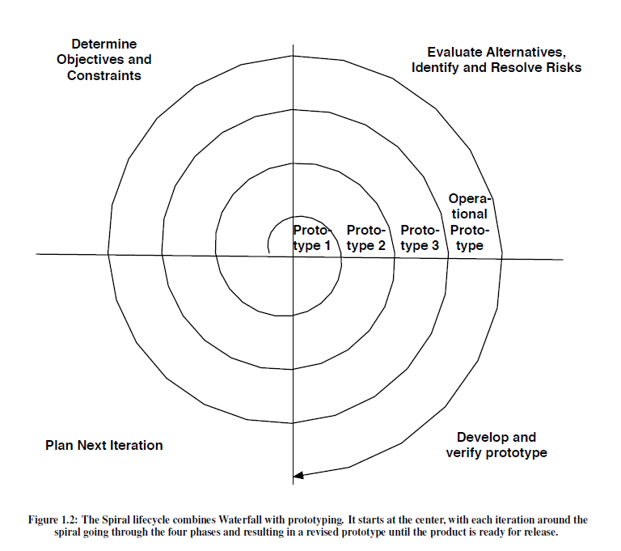
Software Development Processes: Waterfall
Spiral model(1986):
iterate through a sequence of four phases, with each iteration resulting in a prototype that is a refinement of the previous version.
Phases:
1. Determine objectives and constraints of this iteration
2. Evaluate alternatives and identify and resolve risks
3. Develop and verify the prototype for this iteration
4. Plan the next iteration

Slide 5
Software Development Processes: Waterfall
Spiral model(1986):
Rather than document all the requirements at the beginning, as in the Waterfall model, the requirement documents are developed across the iteration as they are needed and evolve with the project.
However, as originally envisioned, these iterations were 6 to 24 months long, so there is plenty of time for customers to change their minds during an iteration! Thus, Spiral still relies on planning and extensive documentation, but the plan is expected to evolve on each iteration.

Slide 6
Software Development Processes: Waterfall
Rational Unified Process (RUP) ((2003):
it is more closely allied to business issues than to technical issues.
Phases:
1. Inception: makes the business case for the software and scopes the project to set the schedule and budget, which is used to judge progress and justify expenditures, and initial assessment of risks to schedule and budget.
2. Elaboration: works with stakeholders to identify use cases, designs a software architecture, sets the development plan, and builds an initial prototype.
3. Construction: codes and tests the product, resulting in the first external release.
4. Transition: moves the product from development to production in the real environment, including customer acceptance testing and user training.
Figure 1.3: The Rational Unified Process lifecycle allows the project to have multiple iterations in each phase and identifies
the skills needed by the project team, which vary in effort over time. RUP also has three “supporting disciplines” not shown
in this figure: Configuration and Change Management, Project Management,

Slide 7
Software Development Processes: Waterfall
Rational Unified Process (RUP) ((2003):
In addition to the dynamically changing phases of the project, RUP identifies six “engineering disciplines” (also known as workflows) that people working on the project should collectively cover:
1. Business Modeling
2. Requirements
3. Analysis and Design
4. Implementation
5. Test
6. Deployment

Slide 8
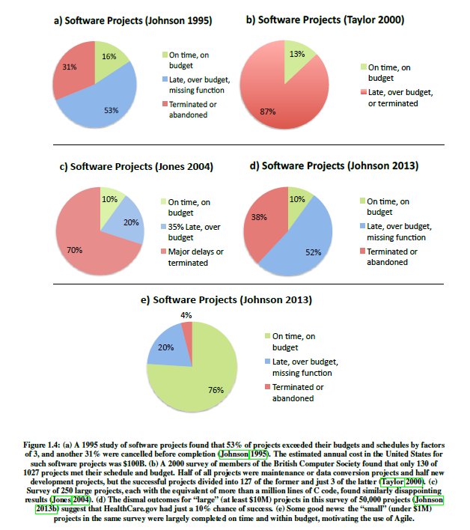
Software Development Processes: Waterfall
Rational Unified Process (RUP) ((2003):
In addition to the dynamically changing phases of the project, RUP identifies six “engineering disciplines” (also known as workflows) that people working on the project should collectively cover:

Slide 9
Failed Software Projects:
Ariane 5 rocket explosion
the Therac-25 lethal radiation overdose
Mars Climate Orbiter disintegration
the FBI Virtual Case File project abandonment so frequently that they are clichés.

Slide 10
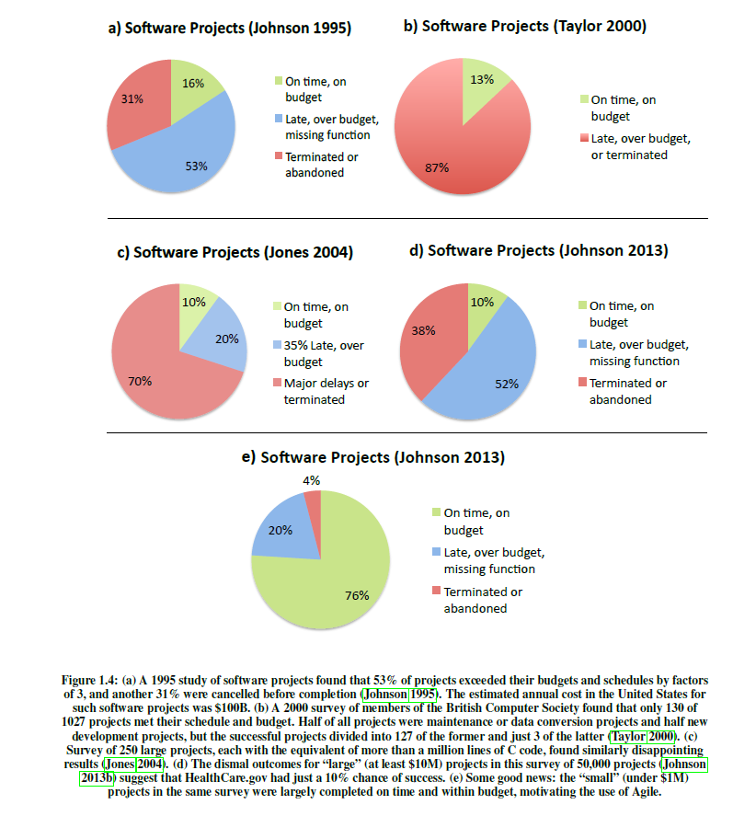
four surveys of software projects

Slide 11
Software Development Processes: Agile Manifesto
Agile Manifesto: a lighter-weight software lifecycle, based on embracing change as a fact of life.
• Individuals and interactions over processes and tools
• Working software over comprehensive documentation
• Customer collaboration over contract negotiation
• Responding to change over following a plan
Agile emphasizes test-driven development (TDD) to reduce mistakes by writing the tests before writing the code
User stories to reach agreement and validate customer requirements
Velocity to measure project progress.

Slide 12
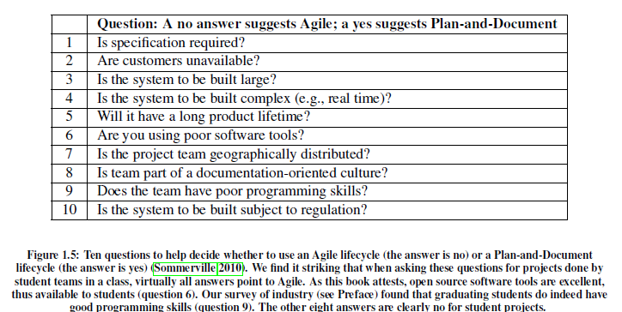

Slide 13
Software Quality Assurance
Software quality means:
Satisfying the customer’s needs—easy to use, gets correct answers, does not crash, and so on
being easy for the developer to debug and enhance
Evaluate a software:
• Verification: Did you build the thing right? (Did you meet the specification?)
• Validation: Did you build the right thing? (Is this what the customer wants? That is, is the specification correct?)
The main approach to verification and validation is testing.

Slide 14
Software Quality Assurance: Testing
the earlier developers find mistakes, the cheaper it is to repair them.
Problem: Given the vast number of different combinations of inputs, testing cannot be exhaustive.
One solution: perform different tests at different phases of software development.

Slide 15
Software Quality Assurance: Testing
integration testing, which ensures that the interfaces between the units have consistent assumptions and communicate correctly. This level does not test the functionality of the units.
unit testing makes sure that a single procedure or method does what was expected.
module testing, which tests across individual units.
For example, unit testing works within a single class whereas module testing works across classes.
system testing or acceptance testing , which tests to see if the integrated program meets its specifications.

Slide 16
Software Quality Assurance
Extreme Programming (XP) version of Agile, which includes one- to two-week iterations, tests before you write the code.
XP splits this test-first philosophy into two parts:
For system, acceptance, and integration tests, XP uses Behavior-Driven Design (BDD), which asks questions about the behavior of an application before and during development so that the stakeholders are less likely to miscommunicate.
For unit and module tests, XP uses Test-Driven Development (TDD), which advocates the use of tests to drive the development of code.

Slide 17
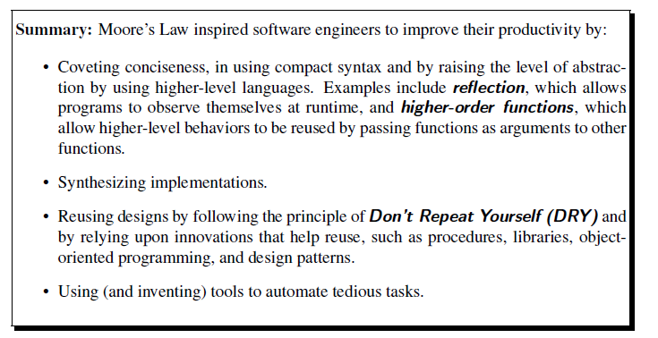
Productivity: Conciseness, Synthesis, Reuse, and Tools

Slide 18
Software as a Service (SaaS)
1. Since customers do not need to install the application, they don’t have to worry whether their hardware is the right brand or fast enough, nor whether they have the correct version of the operating system.
2. The data associated with the service is generally kept with the service, so customers need not worry about backing it up, losing it due to a local hardware malfunction, or even losing the whole device, such as a phone or tablet.
3. When a group of users wants to collectively interact with the same data, SaaS is a natural vehicle.
4. When data is large and/or updated frequently, it may make more sense to centralize data and offer remote access via SaaS.
5. Only a single copy of the server software runs in a uniform, tightly-controlled hardware and operating system environment selected by the developer. Although different Web browsers still have some incompatible behaviors , developers overwhelmingly avoid the compatibility hassles of distributing binaries that must run on different users’ computers.
6. Since the only copy of the server software is under the developers’ control, they can upgrade the software and even the hardware as long as they don’t violate the external application program interfaces (API), and they can pre-test new versions of the application on a small fraction of the real customers first, all without pestering users to upgrade their installed applications.
7. SaaS companies compete regularly on bringing out new features to help ensure that their customers do not abandon them for a competitor who offers a better service.

Slide 19
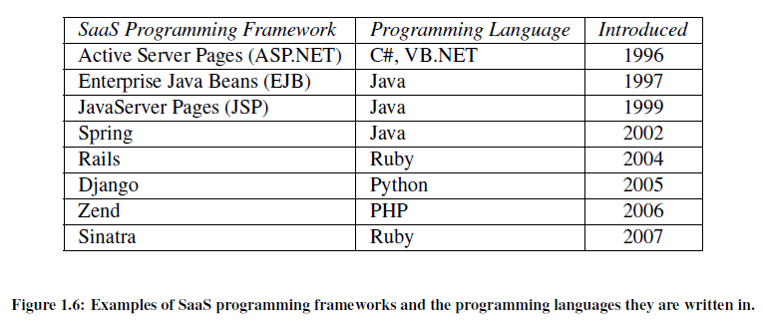
Software as a Service (SaaS)
Idea: rather than relying on users to install software on their computers, why not run the software centrally on Internet-based servers, and allow users to access it via a Web browser?

Slide 20
Software as a Service (SaaS)
service-oriented architecture (SOA), in which a SaaS service could call
upon other services built and maintained by other developers for common tasks.
Services that were highly specialized to a narrow range of tasks came to be called microservices;
Examples:
credit card processing
Search
driving directions

Slide 21
Deploying SaaS: Cloud Computing
SaaS places three demands on information technology (IT) infrastructure:
1. Communication, to allow any customer to interact with the service.
2. Scalability, in that the central facility running the service must deal with the fluctuations in demand during the day and during popular times of the year for that service as well as a way for new services to add users rapidly.
3. Availability, in that both the service and the communication vehicle must be continuously available

Slide 22
Software as a Service (SaaS)
The Internet and broadband to the home easily resolve the communication demand of SaaS.
Although some early web services were deployed on expensive large-scale computers—a contrarian approach soon overtook the industry.
Collections of commodity small-scale computers connected by commodity Ethernet switches, which became known as clusters.

Slide 23
Software as a Service (SaaS)
• Because of their reliance on Ethernet switches to interconnect, clusters are much more scalable than conventional servers. Early clusters offered 1000 computers, and today’s datacenters contain 100,000 or more.
• Careful selection of the type of hardware to place in the datacenter and careful control
of software state made it possible for a very small number of operators to successfully
run thousands of servers.
In particular, some datacenters rely on virtual machines to simplify operation. A virtual machine monitor is software that imitates a real computer so successfully that you can even run an operating system correctly on top of the virtual machine abstraction that it provides (Popek and Goldberg 1974).
The goal is to imitate with low overhead, and one popular use is to simplify software distribution within a cluster.
In this way, multiple apps can share hardware with each app even believing it has its own copy of the operating system. If the apps are also able to share the operating system, an even more efficient way to share hardware is to use OS-level virtualization

Slide 24
Software as a Service (SaaS)
The result is called public cloud services, utility computing, or often simply cloud computing, which offers computing, storage, and communication at pennies per hour.

Slide 25
Deploying SaaS: Browsers and Mobile
The browser thus became a universal client: any site the browser visited could deliver all the information necessary to render that site’s user interface using HTML, the Hypertext Markup Language.
JavaScript entered the picture later as a way to enrich the interactive experience of Web pages, but the actual visible page content always consists of HTML.
HTML is an example of a markup language: it combines text with markup (annotations about the text’s structure) in a way that makes it easy to syntactically distinguish the two.
Technically, HTML 5 is just one type of document that can be expressed in XML, an eXtensible Markup Language that can be used both to represent data and to describe other markup languages.

